Slide 1







2017
2017
Build an immutable application infrastructure with Nano Server, PowerShell DSC, and the
release pipeline
Breakdown the GUI
PowerShell logging to automate everything
Ravikanth Chaganti
Jaap Brasser

Slide 2
Agenda
How to use PowerShell logging
Demo – Setup PowerShell logging
Demo – PowerShell logging to expose Server Manager
Demo – Use Procmon to log and automate
Summary and Questions

Slide 3

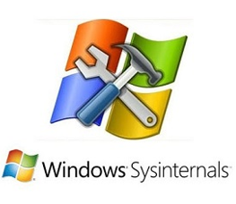
Methods for logging
PowerShell Logging Sysinternals - Procmon

Slide 4
Demo
Setting up PowerShell logging

Slide 5
Demo summary
Setup scriptblock logging
Setup transcription logging
How to setup locally using mmc
How to configure in Active Directory

Slide 6
Demo
Using PowerShell logging to expose server manager

Slide 7
Demo summary
Setup server with IIS
Look at both transaction logs content
Look at eventlogs and their content
What is the Server Manager module

Slide 8

Beyond PowerShell logging

Slide 9
Demo
Show Procmon capabilities

Slide 10
Demo summary
Intro to Procmon
Create procmon filters
Use Start-Procmon.ps1 to gather data
Filter the data and get results
Use the results to build scripts

Slide 11
Summary
How to configure PowerShell logging
How to use PowerShell logging to automate
How to use Procmon to automate

Slide 12
Next Steps...
Now: 15 min break
Grab a coffee
Stay here to enjoy next presentation
Change track and switch to another room
Ask me questions or meet me in a breakout session room afterwards

Slide 13
Questions?

Slide 14


About_Jaap
Dutch PowerShell User Group
Blogging
Slack
Reddit
GitHub
PowerShell Gallery
TechNet Forums/Gallery
@Jaap_Brasser
Jaapbrasser.com/about

Slide 15
2018
psconf.eu 2018
scheduled to be in the week of
April 16-20, 2018
details on www.psconf.eu as they become available

